Slide 1
Housing Allowance
What Every Pastor Needs to Know

Slide 2
Agenda
What is Different about Pastors?
Determining your Housing Allowance
What counts as a Housing Expense?
Impact on your taxes?
What is Housing Allowance?

Slide 3
What is Housing Allowance?
Housing Allowance is a portion (up to 100%) of your ministry income that you use to rent, own, and operate your home.
Housing Allowance does NOT change your total salary – it is just a portion of your salary

Slide 4
Who is Eligible for Housing Allowance?
Must be a licensed or ordained minister
Only for income earned performing “ministerial services”
Cannot include income earned for non-ministerial work even if working for the church (e.g., janitor)
Cannot designate income outside the church (e.g., Uber, Lyft)

Slide 5
Income Taxes (federal, state, and city)
Non-Pastor
Pastor
Pays Income Taxes on All income :
Does not pay income taxes on the portion of income designated as Housing Allowance

Slide 6
Employment Taxes (aka Payroll Taxes, Social Security taxes)
 | Pastor | Non-Pastor
Type of employment taxes? | SECA | FICA
What income is it paid on? | All Income including Housing Allowance | All Income
How much does the employee pay? | ~ 14% | 7.65%
How much does the employer pay? | n/a | 7.65%

Slide 7
Determining your Housing Allowance

Slide 8
Housing Allowance Amount will be the lesser of three things
The amount approved by the church board
Actual housing expenses
Fair Rental Value (FRV) of your furnished home plus annual cost of utilities

Slide 9
1. Church Board Approval
The IRS requires the church board must approve a housing allowance amount before you start receiving payment.
Typically, pastors will submit their request for housing allowance to the board for approval in December
The amount the board approved must be documented in the board’s minutes (keep records of this amount!)

Slide 10
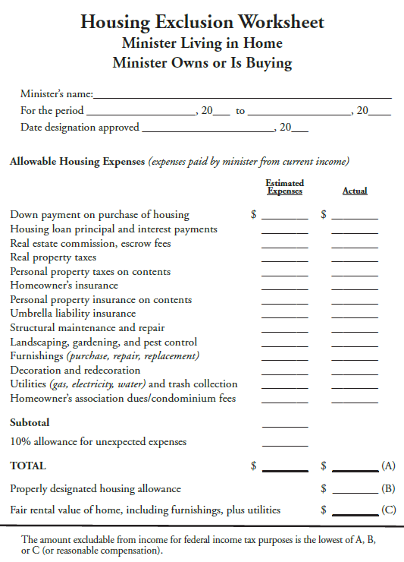
1. Church Board Approval (continue)
How much should you request the board approve for you?
Estimate your housing expenses for the upcoming year
It can be helpful to use a form (see example) that includes all the categories of eligible expenses
Request the board approve 10% more than estimated expenses to give yourself some margin

Slide 11
2. Actual Housing Expenses
What can you include as expenses?
Housing Allowance worksheet
Keep for your records
Keep blank copy on hand for future years
You are responsible for keeping all receipts throughout the year
Do not give receipts to the church
Keep receipts with tax records

Slide 12
3. Fair Rental Value
Determine the value of your home
Find a realtor to help or Zillow
Determine value of furniture
½ value of your home
3. Add value of home + value of furniture together, then multiply by .08
4. Calculate annual cost of utilities
Includes gas, electric, water, trash
5. Add #3 + #4 together to get FRV of furnished home + utilities
Keep documentation in your records

Slide 13
What amount to will be reported on your taxes?
Compare 1, 2, and 3 – declare the lowest amount

Slide 14
Can you change your housing allowance after it has been approved?
Why would you want to change your housing allowance?
If you have large housing expense you didn’t know about at the beginning of the year (for example, a roof repair or remodeling)
If you planned on a large expense but then are not going to do it this year
How do you do it?
Sub a new request and the board approves it.
But this will only impact the income you earn after the change is approved (so request the change ASAP In the year!)
Yes!

Slide 15
What if your actual expenses up being end less than what you the Board approved?
Congratulations and well done! That is your GOAL every year – that your actual expenses would be slightly less than the amount the Board approved
If your actual expenses are higher than what the board approved, you misses out on tax savings
But you don’t want to overestimate too much otherwise you won’t withhold enough in taxes and will end up with a big tax bill

Slide 16
Comparison of Pastor & Non-Pastor
Example
$40,000 Income
$20,000 Housing Allowance
No Children (yet!)

Slide 17
Federal Income Taxes
 | Pastor | Non-Pastor | Difference
Wages | $40,000 | $40,000
Minus Housing Allowance | ($20,000) | $0
Taxable Wages | $20,000 | $40,000
Standard Deduction | ($27,700) | ($27,700)
Ded. Self Employment Taxes | ($2,826) | $0
Taxable Income | $0 | $12,300
Federal Income taxes | $0 | $1,230 | ($1,788)

Slide 18
State Income Taxes
 | Pastor | Non-Pastor | Difference
Wages | $40,000 | $40,000
Minus Housing Allowance | ($20,000) | $0
Taxable Wages | $20,000 | $40,000
Exemptions @ $5,000 per person | ($10,000) | ($10,000)
Taxable Income | $10,000 | $30,000
State Income Taxes at 4.25% | $425 | $1,275 | ($850)

Slide 19
Employment Taxes
 | Pastor | Non-Pastor | Difference
Wages | $40,000 | $40,000
SECA / FICA | $5,652 | $3,060 | $2,592
 | 14.13% | 7.65%

Slide 20
New to Housing Allowance?
Estimate your housing expenses for the rest of the year and get Board approval
Do this ASAP so you can start taking advantage of housing allowance immediately
Start saving all receipts and records of housing expenses!
Adjust your Payroll Withholdings
You may need an accountant to help you determine your withholdings
As a pastor, you are not required to withhold taxes from your paycheck – instead you can file quarterly estimates. However, we recommend you withhold from your paycheck
Find a local tax accountant who has experience with pastor taxes
I strongly discourage you from doing your own taxes (Turbo Tax) or using a national tax service (such as H&R Block)

Slide 21
Key Takeaways
Housing Allowance must be approved and documented by the board before you get paid each year
Request a housing allowance that is slightly higher than the amount you expect
We strongly recommend finding a tax accountant who works with ministers to help prepare your taxes
The GLR wants to help – please call us with questions
Andy: amiedema@theglr.org
Shari: sbrown@theglr.org

